Slide 1
Team 16
Nancy Jemimah Packiyanathan
Venu Gopal Reddy Yerragunta

Slide 2

Project goal
In this project, we built a machine learning model with Spark Machine Learning Library. In addition to that, we passed our test (30%) data as a streaming data through Apache Kafka and Spark Streaming.
The goal of the project is to predict whether the particular transaction is fraudulent or not.

Slide 3
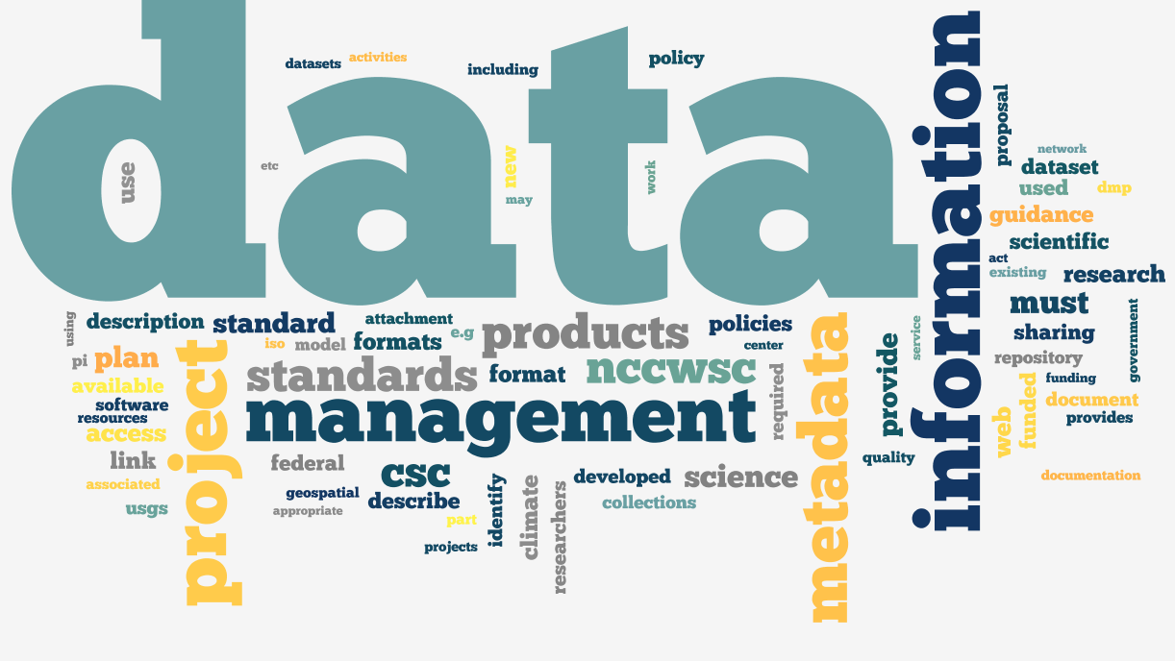
Data source
The data set has 31 features, 28 of which have been anonymized and are labeled V1 through V28. The remaining three features are the time and the amount of the transaction as well as whether that transaction was fraudulent or not.
The data set contains 284,807 transactions.
Source - https://www.kaggle.com/deepanshuluhach/gd-credit-card-fraud

Slide 4
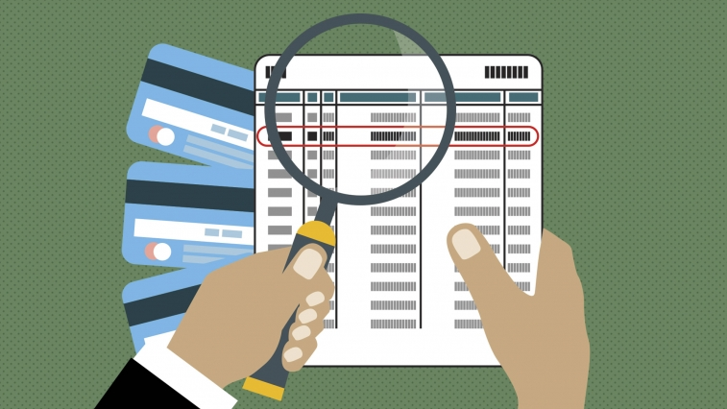
Use case
Actor – Bank Administrator wants to know about the fraudulent transactions.
Action – Data sent to kafka topic.
Reaction – Spark ML model detects fraudulent transactions or not.

Slide 5
Flow of the project
Start Kafka
Data Injestion
Spark subscribes Kafka topic
Run ML model on Streaming data
Predicted Values

Slide 6

methodology
Checked whether our dataset is clean
Created Machine learning model( Random Forest Model) through SPARK ML Library and trained the data.
Apache Kafka and Spark set up has done.
Spark subscribes kafka topic and reads the data.
Trained ML model is applied on the streaming data and the prediction is noted.
CAUTION: VERSION ERRORS IN SPARK

Slide 7

Programming
Our entire project is coded in scala
Spark ML Lib
Spark Streaming

Slide 8
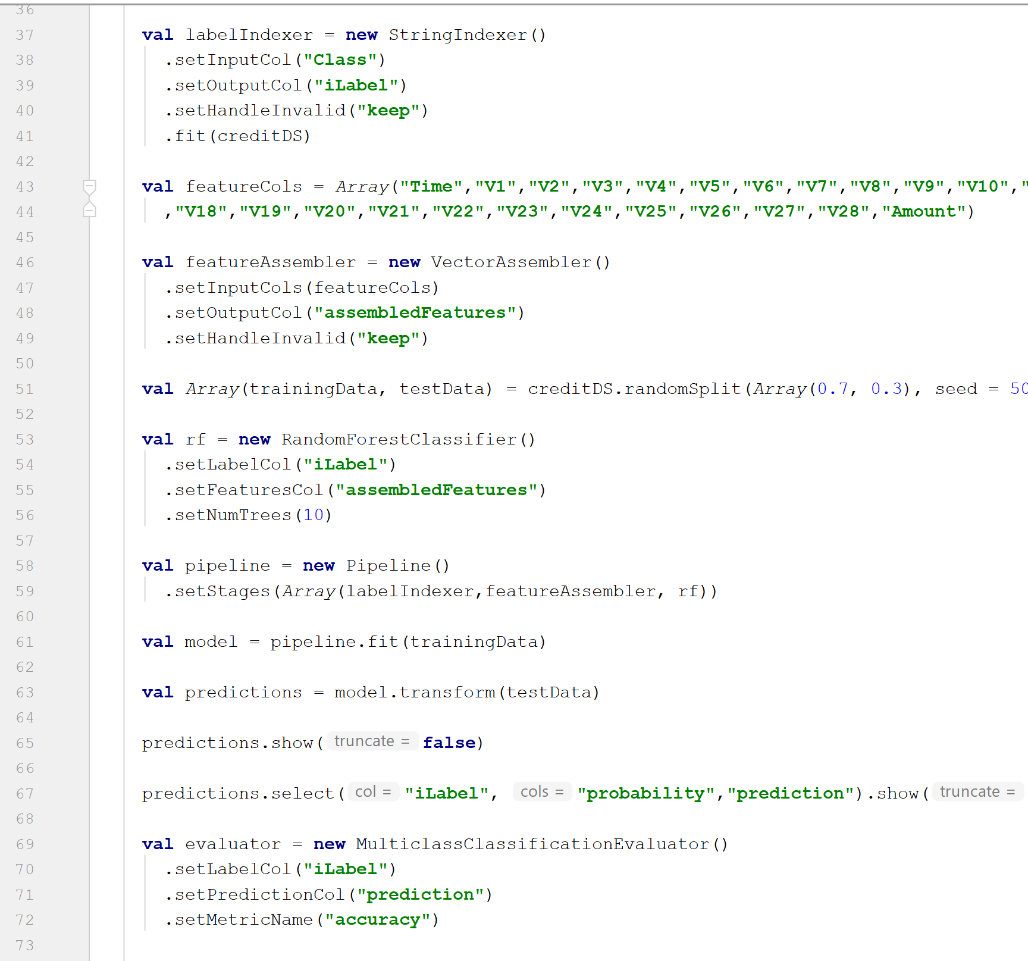
Random Forest Classifier

Slide 9
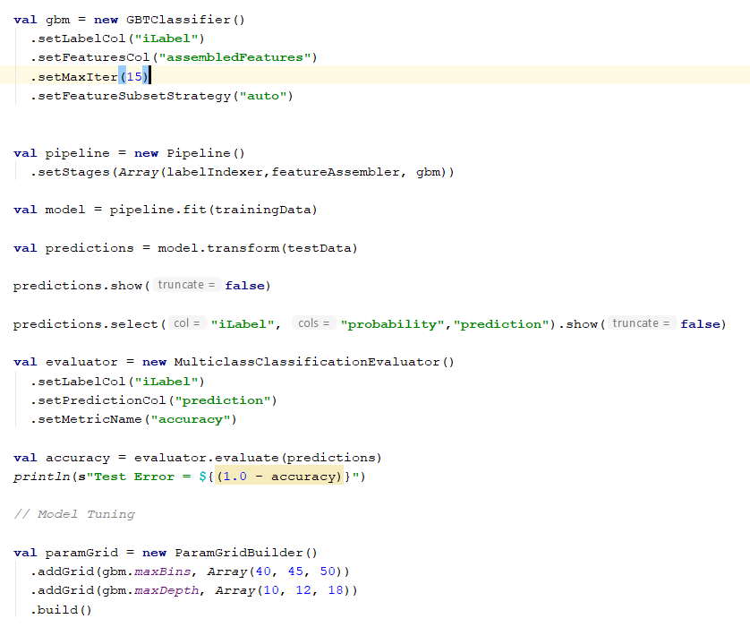
Gradient boosting tree

Slide 10
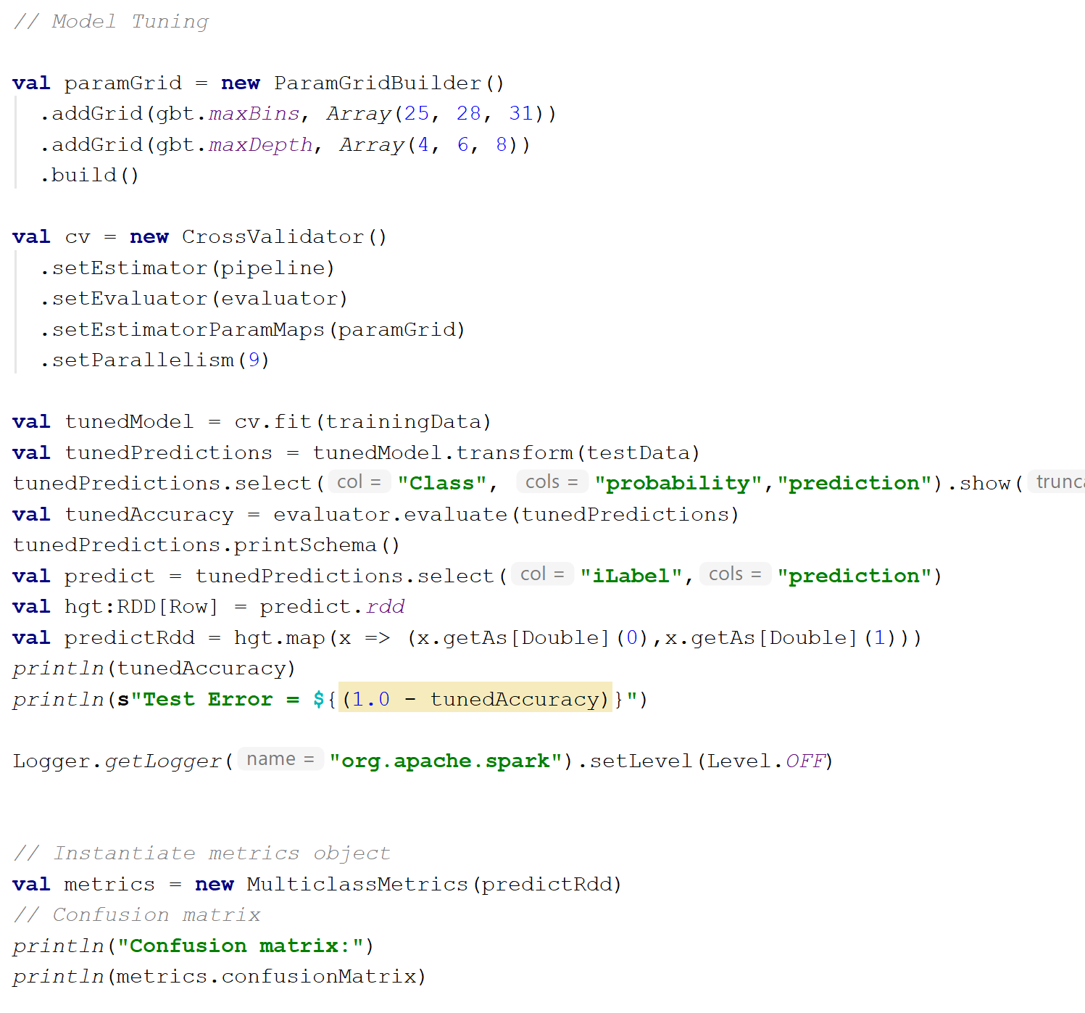
Model tuning & cross validation

Slide 11
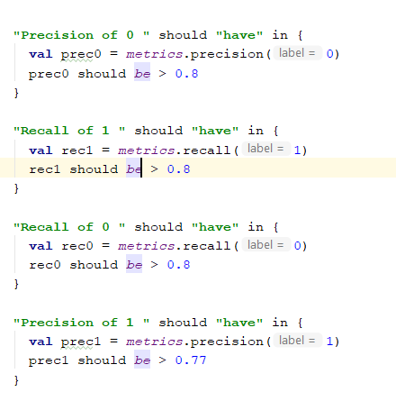
Unit test cases

Slide 12


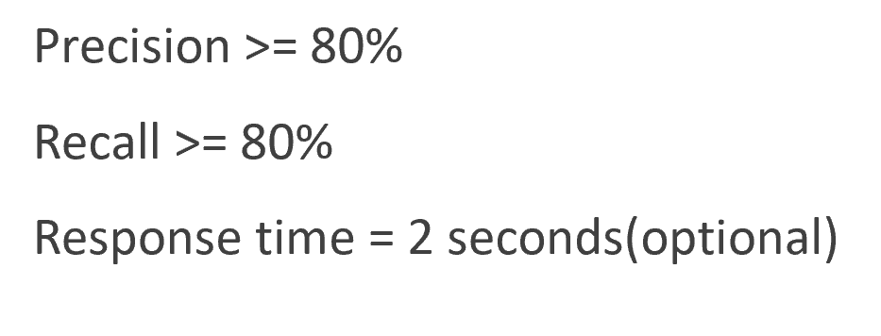
Achieved acceptance criteria
Random Forest precision for class = 1 → 0.78
Random Forest precision for class = 0 → 0.99
Random Forest recall for class = 0 → 0.99
Random Forest recall for class = 1 → 0.91

Slide 13
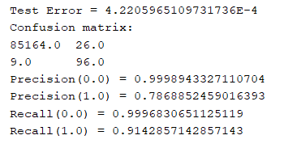
RF Model Metrics

Slide 14
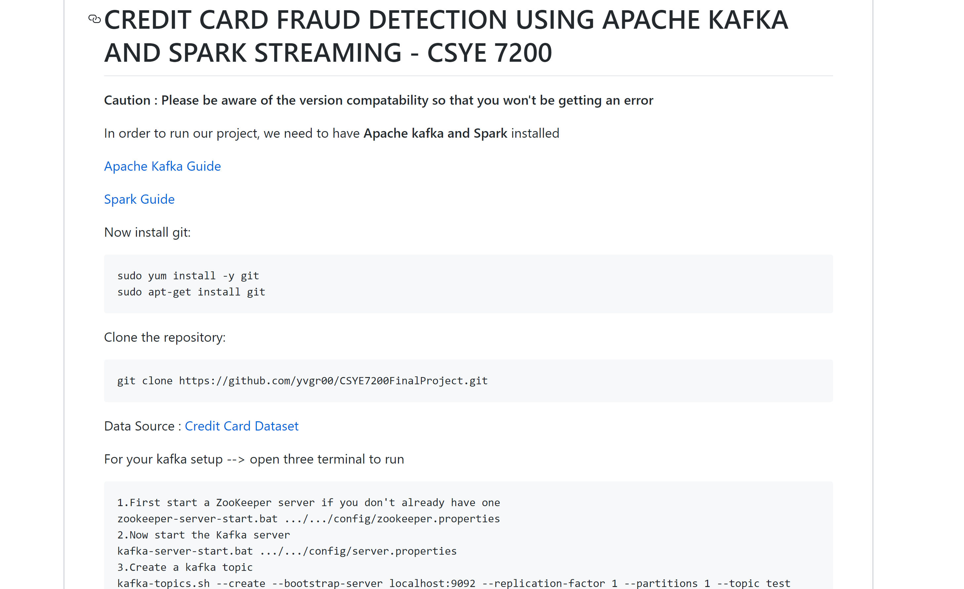
Code repository
Check our work at → https://github.com/yvgr00/CSYE7200FinalProject/tree/master

Slide 15

references
https://www.romexsoft.com/blog/implement-credit-card-fraud-detection/
https://github.com/pavanpkulkarni/CreditCard_Fraud_Detection
https://www.kaggle.com/deepanshuluhach/gd-credit-card-fraud

